Slide 1
AUDIOBOOK
FUTURE OF BOOKS
D.BALU CHANDER
160119737153

Slide 2
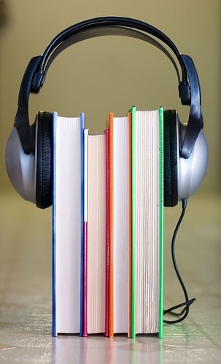
What is an audio book?
A recording of an oral reading of a book, often in abridged form.
Abridged forms such as
audiocassettes, CDs, MP3, etc.
If an audio book is used with the paper copy of the book as well it targets auditory and visual learners.

Slide 3

Pros
Important for Adolescents with busy lives
Good for struggling, blind, disabled, visually impaired readers Gain and improve vocabulary and communication skills Listen to the book and see the words at the same time
Makes interest and confidence go up
It is like being read to aloud so comprehension goes up
Allows struggling readers to hear books above their reading level

Slide 4
LAYOUT OF PROGRAM
AUDIOBOOK
TEXT TO SPEECH
SPEECH TO TEXT

Slide 5
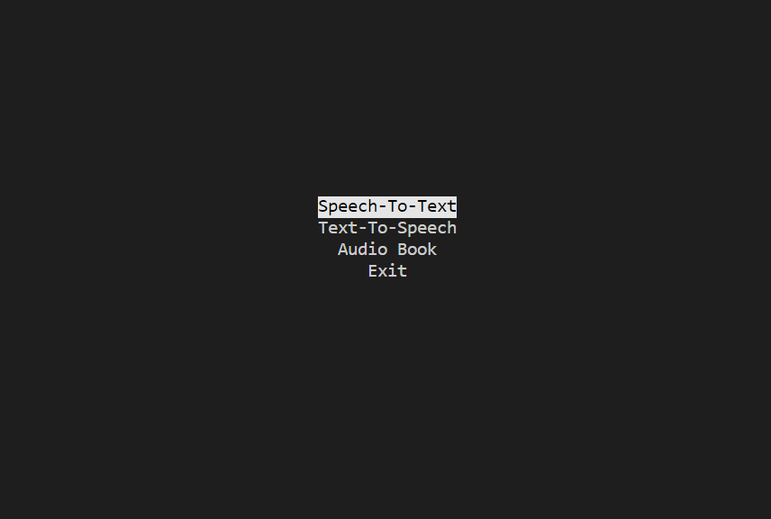
PROGRAM
Consists of three choices:
1.Text to speech
2.Speech to text
3.Audio book

Slide 6
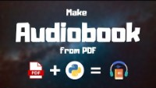
REFERENCE
Audio book converter:

Slide 7
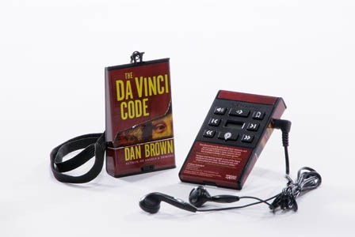
Description
1.Text to speech then the user gets a mp3 file as output which has his text converted into audio.
2. Speech to text then user gets to see the text on the console which he spoke.
3.Audio book then user gets the mp3 file of his pdf

Slide 8

CONCLUSION AND FUTURE SCOPE
This mini project successfully converts the given input which may be text or pdf into mp3 file and inputs like audio into text format.
They are also useful for the blind
There is no doubt about the fact
that audiobooks are the future of
books.

